Slide 1
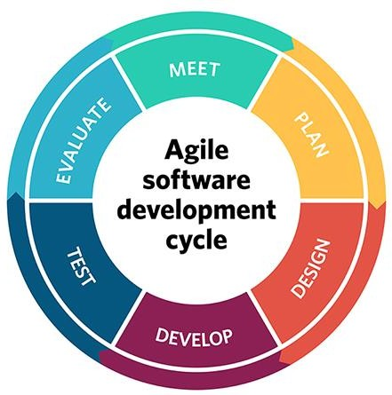
3. Agile Model

Slide 2
Topics Covered
What is agility?
12 Agile Principles
Agile Models
2

Slide 3
Rapid software development
Rapid development and delivery is now often the important requirement for software systems
Businesses operate in a fast –changing requirement and it is practically impossible to produce a set of stable software requirements
Software has to evolve quickly to reflect changing business needs.
Rapid software development
Specification, design and implementation are inter-leaved
System is developed as a series of versions with stakeholders
involved in version evaluation
User interfaces are often developed using an IDE and graphical toolset.
3

Slide 4
What is Agile Development?
Agile is an emerging software development methodology
Programming-centric
Few rules and practices
Easy to follow
Eliminate much of modeling and documentation tasks – saves time
Emphasize simple, iterative application development

Slide 5
Agile methods
Dissatisfaction with the overheads involved in software design methods of the 1980s and 1990s led to the creation of agile methods. These methods:
Focus on the code rather than the design
Are based on an iterative approach to software development
Are intended to deliver working software quickly and evolve quickly to meet changing requirements.
The aim of agile methods is to reduce overheads in the software process (e.g. by limiting documentation) and to be able to respond quickly to changing requirements without excessive rework.

Slide 6
Agile manifesto
We are uncovering better ways of developing software by doing it and helping others do it. Through this work we have come to value:
Individuals and interactions over processes and tools Working software over comprehensive documentation Customer collaboration over contract negotiation Responding to change over following a plan
That is, while there is value in the items on the right,we
value the items on the left more.

Slide 7
What is “Agility”?
Ability to move quickly and easily.
Effective (rapid and adaptive) response to change
Effective communication among all stakeholders
Drawing the customer onto the team
Organizing a team so that it is in control of the work performed Yielding or Soft …
Rapid, incremental delivery of software
3

Slide 8
When to use Agile Model
When new changes are needed to be implemented. The freedom agile gives to change is very important. New changes can be implemented at very little cost because of the frequency of new increments that are produced.
To implement a new feature the developers need to lose only the work of a few days, or even only hours, to roll back and implement it.
Unlike the waterfall model in agile model very limited planning is
required to get started with the project. Agile assumes that the end users’ needs are ever changing in a dynamic business and IT world. Changes can be discussed and features can be newly effected or removed based on feedback. This effectively gives the customer the finished system they want or need.
Both system developers and stakeholders alike, find they also get more freedom of time and options than if the software was developed in a more rigid sequential way. Having options gives them the ability to leave important decisions until more or better data or even entire hosting programs are available; meaning the project can continue to move forward without fear of reaching a sudden standstill.
4

Slide 9
12 Agility Principles
Our highest priority is to satisfy the customer through early and continuous delivery of valuable software.
Welcome changing requirements, even late in development. Agile processes harness change for the customer's competitive advantage.
Deliver working software frequently, from a couple of weeks to a
couple of months, with a preference to the shorter timescale.
Business people and developers must work together daily throughout the project.
Build projects around motivated individuals. Give them the environment and support they need, and trust them to get the job done.
The most efficient and effective method of conveying information to and within a development team is face–to–face conversation.
5

Slide 10
12 Agility Principles(Cont..)
Working software is the primary measure of progress.
Agile processes promote sustainable development. The
sponsors, developers, and users should be able to maintain a constant pace indefinitely.
Continuous attention to technical excellence and good design enhances agility.
Simplicity – the art of maximizing the amount of work not done – is essential.
The best architectures, requirements, and designs emerge from self–organizing teams.
At regular intervals, the team reflects on how to become more effective, then tunes and adjusts its behavior accordingly.
6

Slide 11
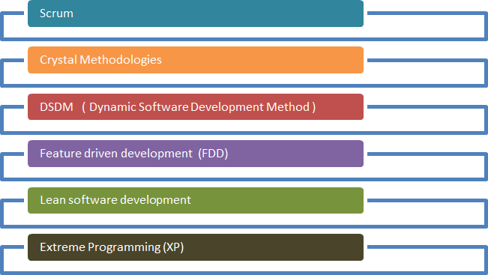
Agility Methodology
7

Slide 12
Extreme Programming(XP)
XP uses an object oriented approach.
XP encompasses a set of rules and practice that occur within the context of four framework activities.
XP Planning
XP Design
XP Coding
XP Testing
8

Slide 13
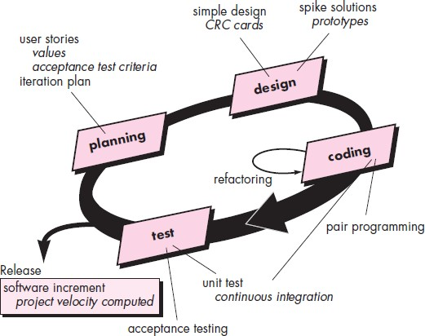
Extreme Programming(XP)
9

Slide 14
Extreme Programming(XP)
There are four basic activities that XP proposes for software development process :
XP Planning :
The planning activity begins with the creating of a set of stories that describe required features and functionally for software to be built.
Each stories is written by the customer and placed on an index card.
The customer assign a value to the story on the overall business value of the feature or function.
- ¨Members of the XP
development week to it.
2. XP Design:
team the access each story and assign a cost measured in
XP design follows the KIS-Keep it simple principle.
A simple design is always preferred over a more complex representation.
The design provides implementation giddiness for a story as it is written nothing less,
nothing more.
The XP team conducts the design exercise using a process and the CRC cards are the only design work product produced as the part of XP process.
XP recommends the immediate creating of an operational prototype of that portion of the design called spike solution.
10

Slide 15
Extreme Programming(XP)
XP Coding :
XP recommends that after stories are developed and preliminary design is done, the
team should not move to code, but rather develop a series of unit test.
Once the code is complete, it can be unit tested immediately, thereby providing instaneous feedback to the developers.
During the coding activity is pair programming.
XP recommends that two people work together at one computer work station to create code for a story. This provides a mechanism for real time problem solving and real time quality assurance.
XP Testing:
The creation of unit test before coding commence is a key element of the XP approach.
The unit test that are created should be implemented using a framework the enable them to be automated.
Integration and validation testing of the system can occur a daily basis.
XP acceptance test, also called customer test are specified by the customer and focus on overall system.
11

Slide 16
Adaptive Software Development(ASD)
Originally proposed by Jim Highsmith
ASD technique proposed for building complex software and system.
ASD focus on human collaboration and team-self- organization.
ASD incorporates three phases:-
Speculation
Collaboration
Learning
12

Slide 17
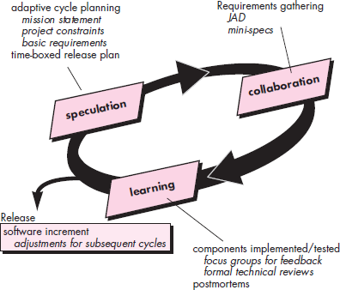
Adaptive Software Development
13

Slide 18
ASD Three Phases
Speculation:
During speculation , the project is initiated and adapted cycle planning is
conducted.
Adapting cycle planning uses project initiation – information the customers mission statement, project constraints and basic requirements to define the set of release cycle.
Collaboration
The collaboration approach is requiring theme in all agile methods, but collaboration is not easy.
It is not simply communicate, although communicate is a part of it.
It is nota rejection individualism, because individual creativity plays on important role in collaboration thinking.
People working together must trust one another to:-
Criticize without animosity
Assist without resentment.
Work as hard of harder as they do.
Have the skill set to contribute to the work at hard
Communicate problem
14

Slide 19
Adaptive Software Development
Learning
ASD teams learns three ways:-
Focus Group:
The customer or end user provide feedback on software increments that are being delivered.
Formal technical review:
ASD team members review the software components that are develop,
improving quality and learning as they proceed.
Postmaster
The ASD team becomes introspective , addressing its own performance and process.
15

Slide 20
Dynamic Systems Development (DSD) Method
The Dynamic System Development method (DSDM) is an agile software development approach that provides a framework for building and maintain system which meet tight time constraints through the use of incremental prototyping in a controlled project environment.
The DSDM life cycle defines, three iterative cycle precede by two additional life cycle.
Feasibility study
Business study
Functional model iteration
Design and iteration
Implementation
16

Slide 21
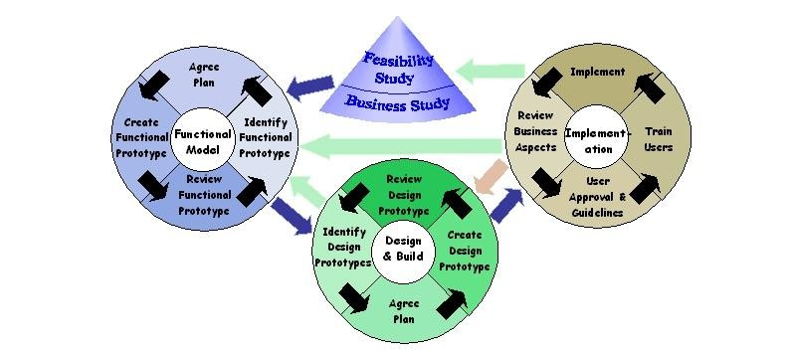
Dynamic Systems Development (DSD) Method
17

Slide 22
DSDM Iterative life cycle
Feasibility study
Established the basic business requirements and constraints associated with
the applicants to be built.
Business study
Establishes the functional information requirements that will allow the applicants to provide business value.
Functional model iteration
Produce a set of incremental prototype that demonstrate functionality for the customer.
Design and iteration
Revisits prototype built during the functional model iteration to ensure that each has been engineered in a manner.
Implementation
Places the latest software increment into the operational environment.
It should be noted that-
The increment may not be 100 percent complete
Changes may be requested as the increment is put into place.
18

Slide 23
Scrum Agile Process
Scrum is an agile software development method that was conceived by Jeff Sutherland and his development team in the early 1990s.
In recent years, further development on the Scrum methods has been performed by Schwaber and Beedle
Scrum principles are consistent with the agile manifesto and are used to guide development activities within a process that incorporates the following framework activities: requirements, analysis, design, evolution, and delivery.
19

Slide 24
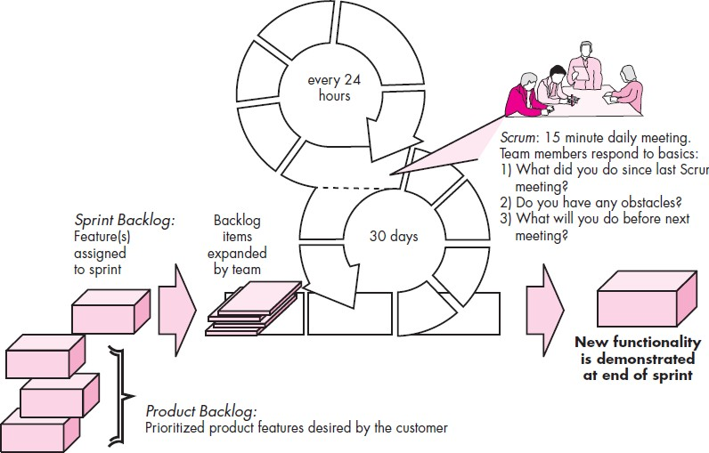
Scrum Agile Process
20
Fig: Scrum Process Flow

Slide 25
Scrum Agile Principles
Small working teams are organized to maximize communication, minimize overload and maximize sharing tacit, informal knowledge.
The process must be adaptable to both technical and business changes – to ensure the best possible product is produced.
The process yields frequent software increment that can be
inspected, adjusted, tested , documented and built on.
Development work and people who perform it are partitioned into clean low coupling partitions or packets.
Constant testing and documentation is preferred as the product is built.
The scrum process provides the ability to declare a product done whenever required.
21

Slide 26
References:
Software Engineering A practitioner’s Approach
by Roger S. Pressman, 7th edition, McGraw Hill, 2010.
Software Engineering by Ian Sommerville,
9th edition, Addison-Wesley, 2011
22

Slide 27
Assignment:
Write down the definition, application, advantages and disadvantages with figure of give software model.
Waterfall Model
V-Model
Incremental Model
Spiral Model
Concurrent Model
Unified Process(UP) Model
Extreme Programming(XP)
Adaptive Software Development (ASD)
Scrum Model
Dynamic Systems Development Method (DSDM)
What are the Software Development Models? http://istqbexamcertification.com/what-are-the-software-development-models/
12 BEST SOFTWARE DEVELOPMENT METHODOLOGIES WITH PROS AND CONS
http://acodez.in/12-best-software-development-methodologies-pros-cons/
23
Choosing the right Software development life cycle model https://melsatar.blog/2012/03/21/choosing-the-right-software-development-life-cycle-model/

